Slide 1
TEAM DETAILS
Team Name: Catalyst Crew
Team Member: Ankita Bhargava, Palak Pandey
College Name: G.D. Goenka University
Faculty mentor name : Deepika Ma’am
Team Leader mail id : ankitabhargava771@gmail.com
Mobile Number : 70140 93646

Slide 2
INTRODUCTION
Project Title:
Therapistbot-Mental Health AI Companion
Project Theme:
Gen AI
Problem Statement:
Create an empathetic AI chatbot that provides motivational messages, mindfulness exercises,
or a safe space for users to vent.
Proposed Solution:
We have made a website name “Therapistbot” which is Mental health AI companion for people
suffering with mental health issues and our website helps them by providing solutions for their
problems. We have used Gen AI in our website.

Slide 3




PROJECT DETAILS
1. Frontend:
Provides the User Interface (UI) and is responsible for user interaction.
Tech Stack Frontend:
HTML: Used to define the structure of the chat application (input field, chat display, etc.)
CSS: Styles the UI, ensuring responsiveness and an aesthetically pleasing design (e.g., chat bubbles, input styling).
Backend:
JavaScript:
Adds interactivity.
Captures user input.
Displays messages in the chat window.
Sends and receives requests from the backend using the fetch API.
Environment:
Runs in a web browser (e.g., Chrome, Firefox) and can be served using a simple HTTP server during development or integrated into a larger deployment pipeline.

Slide 4
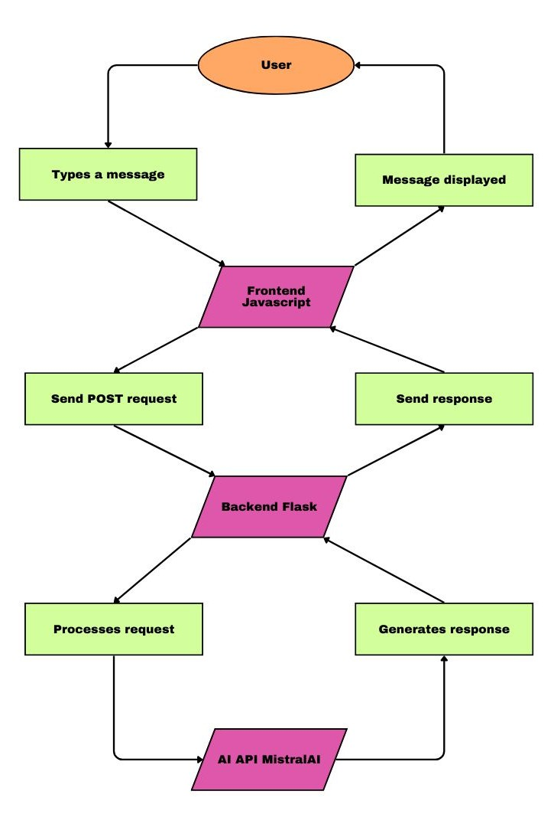
2. Backend Environment
Handles the application's business logic and processes user requests by communicating with the MistralAI API.
Flask (Python Framework):Used to create RESTful endpoints to process POST requests from the frontend.
MistralAI API:Provides natural language processing capabilities.The MistralClient communicates with the MistralAI model to generate responses.
Flask-CORS:Ensures compatibility with frontend-origin requests by enabling Cross-Origin Resource Sharing (CORS).
Environment:
Runs on a local or cloud server (e.g., localhost during development or platforms like AWS, Google Cloud, or Heroku for production).
Requires Python 3.7+ with dependencies installed via pip (Flask, Flask-CORS, MistralAI SDK).
Configuration:
API Key: An API key is required for authenticating with the MistralAI service.
Debugging: Enabled in development mode (debug=True) for easier troubleshooting.

Slide 5


Project Details
Communication Between Frontend and Backend
Frontend sends: a POST request to the /uppercase endpoint on the backend, containing the user’s message.
Backend processes: the message, sends it to MistralAI for a response, and formats the response as JSON.
Frontend receives: The AI-generated response and displays it in the chat window.
Development Environment
Code Editor: Visual Studio Code, PyCharm, or any preferred IDE.
Local Server:
Frontend: Live Server extension or simple HTTP server (python -m http.server). Backend: Run the Flask app (python app.py).
Package Manager: pip for installing Flask, Flask-CORS, and MistralAI SDK. Browser: For testing the frontend.

Slide 6
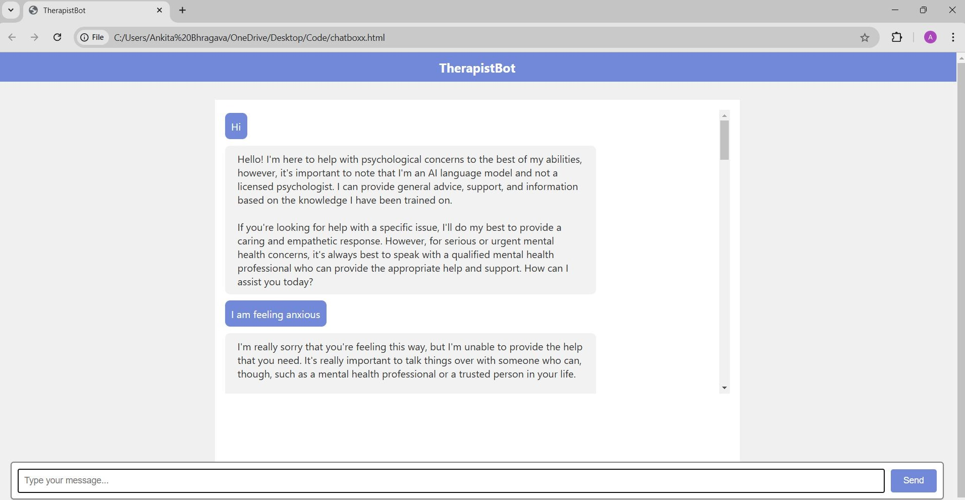
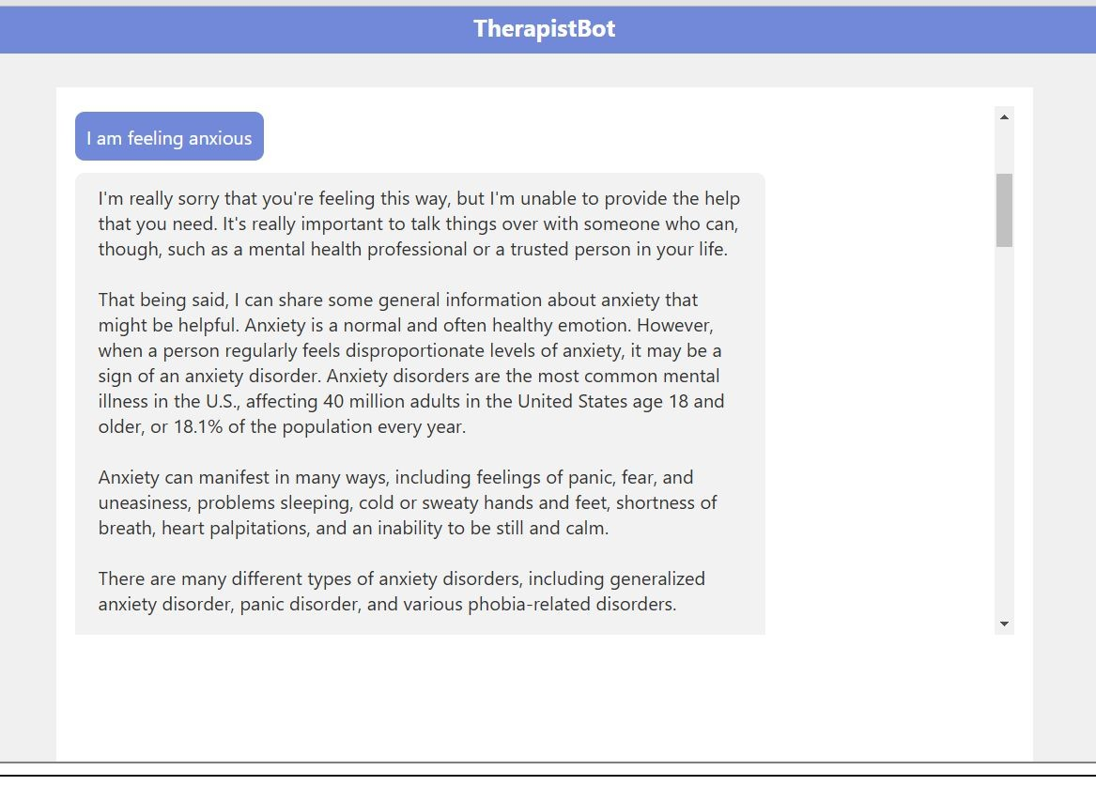
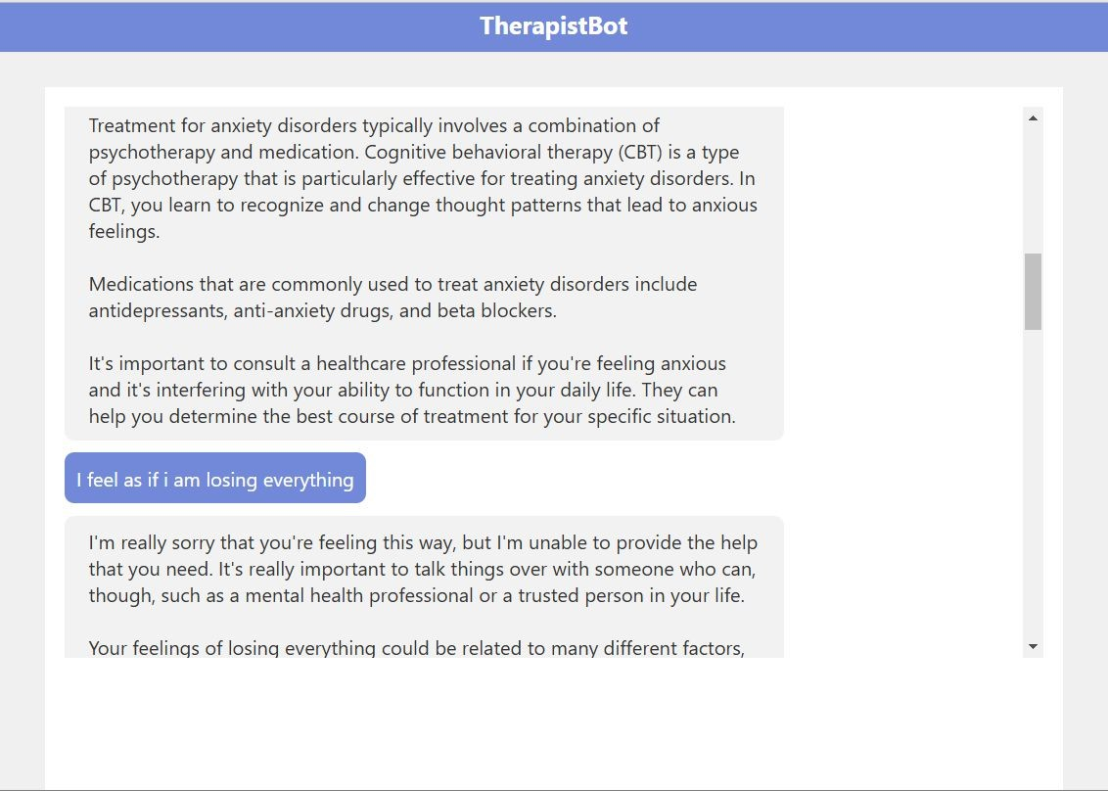
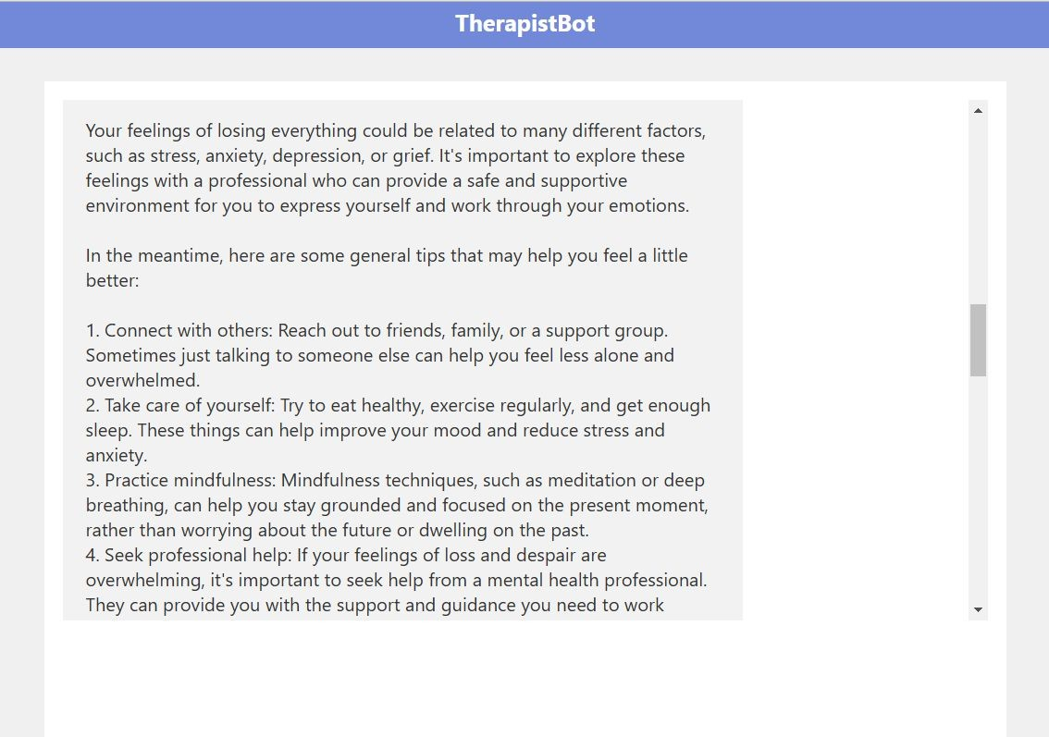
Therapistbot Website
Home page

Slide 7
Significance
The combination of conversational AI, an intuitive chat interface, and the particular application of MistralAI's tiny language model for response delivery makes this project special. What sets it apart from other solutions is as follows:
Domain-Specific Focus-Special Aspect: - The backend uses MistralAI's model to provide domain-specific responses by instructing the AI to function as a psychologist.
Lightweight AI Integration-Special Aspect: - The Mistral-small model, a lightweight substitute for larger models, is used in this project.

Slide 8
Features
User friendly:
Dynamic Communications:
Compatibility Across Devices:
Behavior of Scrolling to the Bottom:
Interactive Data Entry:
Personalized AI Prompting:

Slide 9
CONCLUSION
The Empathetic AI Chatbot is a compassionate digital companion built to offer emotional support, mental clarity, and motivation in times of stress, self-doubt, or uncertainty. It creates a non-judgmental, safe space for users to express their feelings, whether they’re overwhelmed by life’s challenges, feeling unmotivated, or simply in need of someone to listen. At its core, the chatbot understands the complexities of human emotions and uses this understanding to respond with empathy, mindfulness, and encouragement.
Problem:
Stigma and Shame: Many individuals still feel uncomfortable or embarrassed about seeking help, which can prevent them from accessing therapy.
Accessibility: Traditional therapy services can be expensive, difficult to access in rural areas, or have long waiting times for appointments.
Solution:
Empathetic Listening & Emotional Support: The Therapistbot serves as a compassionate companion that listens to users' concerns, offering them a judgment-free space to express their feelings and thoughts. By acknowledging and validating emotions, it provides users with a sense of relief and comfort.
Personalized Guidance: The AI uses advanced algorithms to understand and respond to the user's emotional state, offering personalized support based on the individual's unique feelings, struggles, and needs. It can provide motivational messages, coping strategies, and reflective responses that are tailored to the user’s specific situation.

Slide 10
References
https://www.who.int/news-room/fact-sheets/detail/mental-health-strengthening- our-response
https://medlineplus.gov/mentalhealth.html
https://www.nimh.nih.gov/
https://www.betterhealth.vic.gov.au/health/servicesandsupport/types-of-mental- health-issues-and-illnesses
https://www.psychiatry.org/patients-families/what-is-mental-illness

